Slide 1
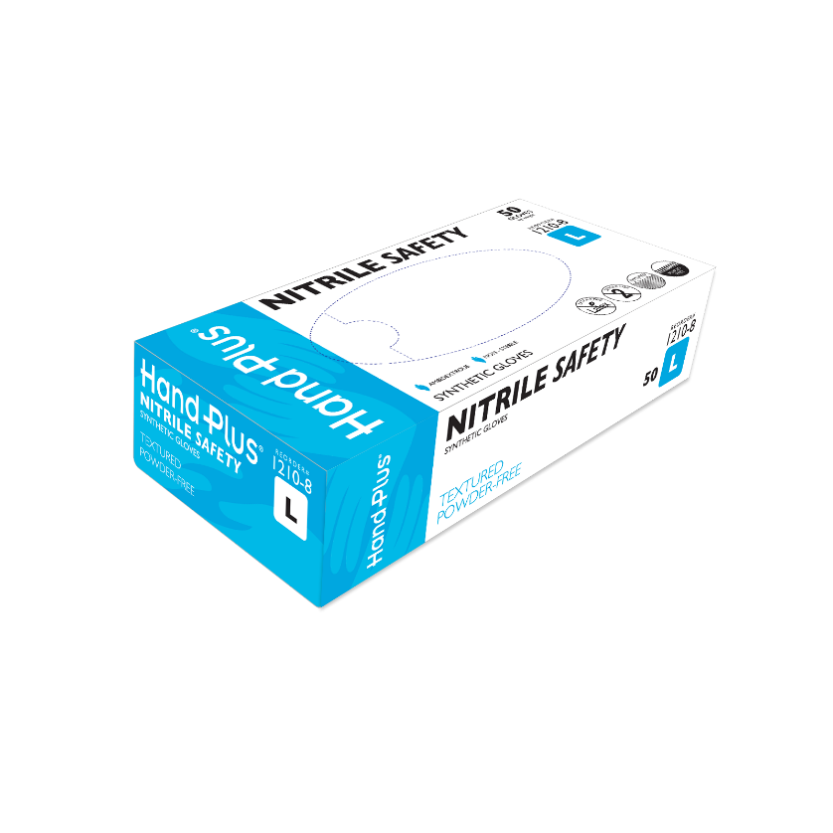
TECHNICAL DATA SHEET
Handplus® Nitrile Safety Synthetic Gloves
Size | Reorder#
X-Small | 1210-5
Small | 1210-6
Medium | 1210-7
Large | 1210-8
X-Large | 1210-9
2X-Large | 1210-0
Features
All specifications are subject to change without notice.
Specification (mm)
Size | Glove Length | Palm Width | Cuff Thickness | Palm Thickness | Finger Thickness
X-Small | 300 | 75 | 0.13 | 0.20 | 0.26
Small | 300 | 85 | 0.13 | 0.20 | 0.26
Medium | 300 | 95 | 0.13 | 0.20 | 0.26
Large | 300 | 105 | 0.13 | 0.20 | 0.26
X-Large | 300 | 115 | 0.13 | 0.20 | 0.26
2X-Large | 300 | 125 | 0.13 | 0.20 | 0.26
Safety Sealed Packaging (S-XL) 50 Gloves/Box, 10 Boxes/Case | Safety Sealed Packaging (XXL) 45 Gloves/Box, 10 Boxes/Case
Soft Nitrile with Easy Donning Feature
Blue Color
10 mil thickness, 12-inch cuff
Superior puncture resistance
Exceptional strength and durability
Textured finish for excellent grip
Better chemical barriers than latex gloves
Excellent tactile sensitivity and comfortable fit
Dated Lot Codes for quality assurance and traceability
Quality Standards
Nitrile Safety Manufacturing Standards
Testing Methods
Meets or exceeds the following standards: ASTM D6319 (USA), EN 455 (EEC), A5 40 (AUSTRALIA), FDA, NFPA and Chemo ASTM 6978
ISO 9002 Certified Manufacturing
Quality sampled in accordance with MIL STD 105E
*Brand new state-of-the-art manufacturing plant with computer-controlled market leading technology
Defect | Inspection Level | AQL
Pinholes (FDA 1000 ml watertight test) | G1 | 1.5
Visual Defects (Major) | G1 | 2.5
Visual Defects (Minor) | G1 | 4.0
Dimensions | S-2 | 4.0
Physical Properties
Property | ASTM Minimum | Nitrile Safety®
 | Before Aging | Before Aging
Tensile (MPa) | 14 | 18
Elongation (%) | 500 | 500
 | After Aging | After Aging
Tensile (MPa) | 14 | 18
Elongation (%) | 500 | 500
©2019, , All Rights Reserved.

